Slide 1
Phytoplankton Physiology Seminar
Week 1, Session 0
Mick Follows, Instructor
Arianna Krinos, Teaching Assistant

Slide 2
Landscape of this brief introduction
The ocean context
The microbial loop + biological carbon pump
Why phytoplankton, though small, are mighty in global ocean ecology + even physics and chemistry
A primer on phytoplankton sizes, functions, and physiological features
An introduction to major taxonomic groups

Slide 3
The oceanic context for phytoplankton communities

Slide 4
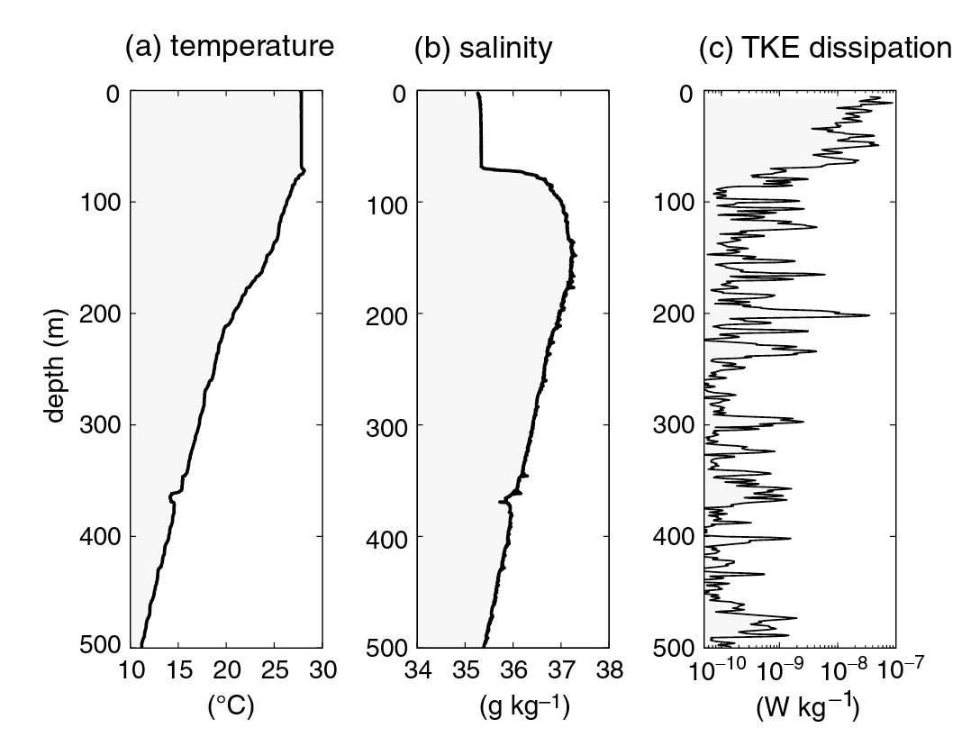
Light and mixing in the upper ocean enables phytoplankton growth

Slide 5
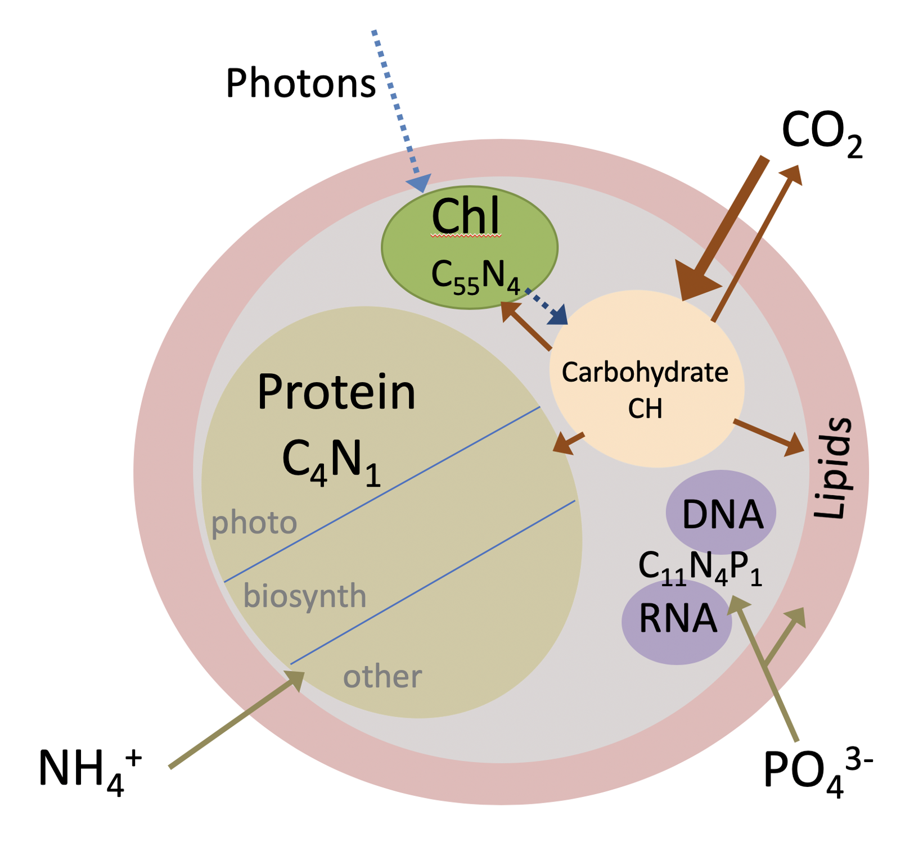
The Redfield Ratio describes average particle nutrient ratios
Average molar elemental composition of phytoplankton
C:N:P:O₂ ≈ 106:16:1:138
Notes:
Highlighted by Alfred Redfield in 1930s
O₂ estimated by Redfield from Redox/thermodynamic considerations
Recent authors find the values aren’t always constant

Slide 6
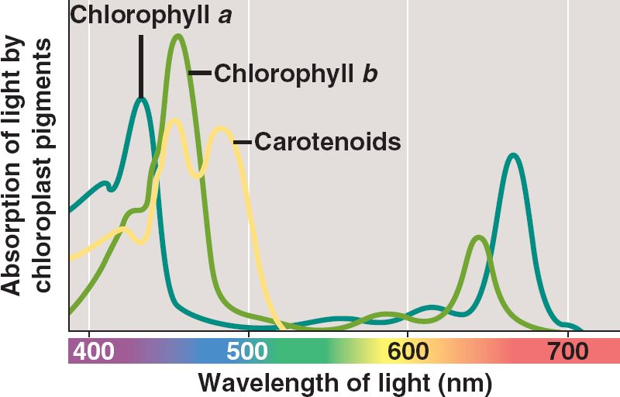
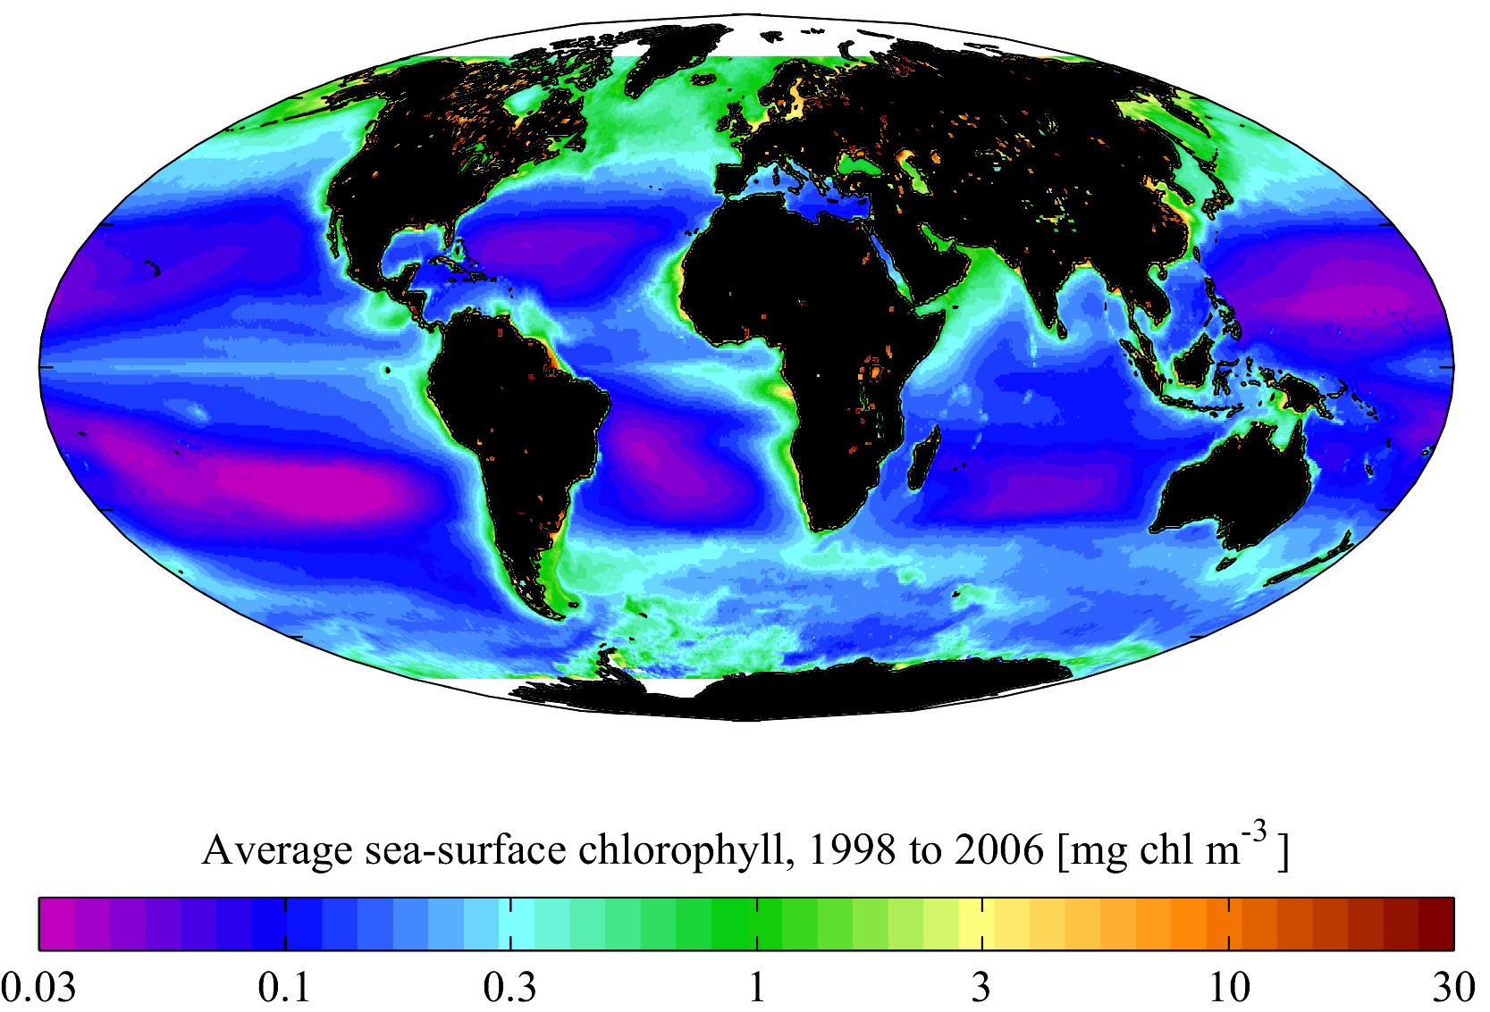
Sea surface chlorophyll measurements help estimate primary production
Chlorophyll absorbs in red and blue, less so in green wavelengths
Calibrate ratio of green/blue light in reflected radiation measured by satellite with in situ measured chlorophyll
Extrapolate globally

Slide 7
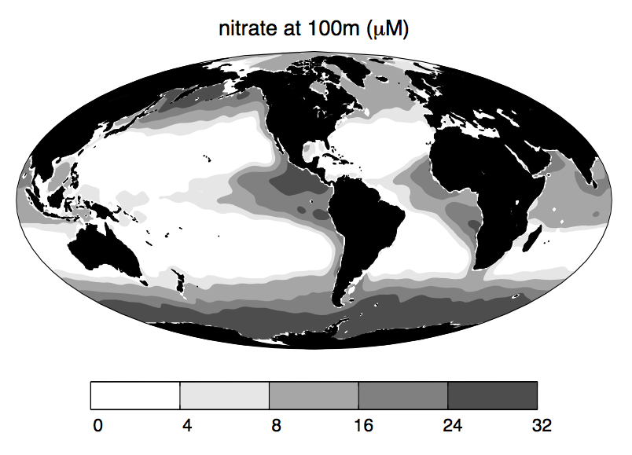
Near surface nitrate concentration reflects pattern of upwelling
Carbon doesn’t typically limit phytoplankton growth – other nutrients do

Slide 8
Why are phytoplankton important?

Slide 9
The traditional paradigm of the ocean food web
Phytoplankton
Zooplankton
Fish

Slide 10
It turns out that this oversimplifies things…
Phytoplankton
Zooplankton
Fish
Some cells leak, or produce compounds via shedding, dissolution, etc. The feeding process also tends to be messy.

Slide 11
It turns out that this oversimplifies things…
Phytoplankton
Zooplankton
Fish
If this was the end of the line, this would be a massive loss from the surface, quickly.

Slide 12
It turns out that this oversimplifies things…
Phytoplankton
Zooplankton
Fish
Instead, organic matter + nutrients are kept cycling in the productive surface oceans via the microbial loop.

Slide 13
It turns out that this oversimplifies things…
Phytoplankton
Zooplankton
Fish
DOM

Slide 14
It turns out that this oversimplifies things…
Phytoplankton
Zooplankton
Fish
DOM
Bacterioplankton
Grazers like flagellates

Slide 15
It turns out that this oversimplifies things…
Phytoplankton
Zooplankton
Fish
DOM
Bacterioplankton
Grazers like flagellates

Slide 16
It turns out that this oversimplifies things…
Phytoplankton
Zooplankton
Fish
DOM
Bacterioplankton
Grazers like flagellates
Larger ciliates

Slide 17
It turns out that this oversimplifies things…
Phytoplankton
Zooplankton
Fish
Closing that loop!
DOM
Bacterioplankton
Grazers like flagellates
Larger ciliates

Slide 18
The microbial loop
In the surface ocean, nutrients cycle
How much eventually gets exported is a crucial detail for climate

Slide 19
The biological carbon pump
Concentration (no scale)
0
Inorganic C exchange
Oxygen exchange
100
Organic C
Surface DIC + N +O₂
euphotic
NO₃⁻ : Nitrate
Organic matter
cycling
Meters depth
DIC
Ocean circulation
Sinking, death, circulation
O₂ : Oxygen
Stored DIC/nitrate
5000

Slide 20
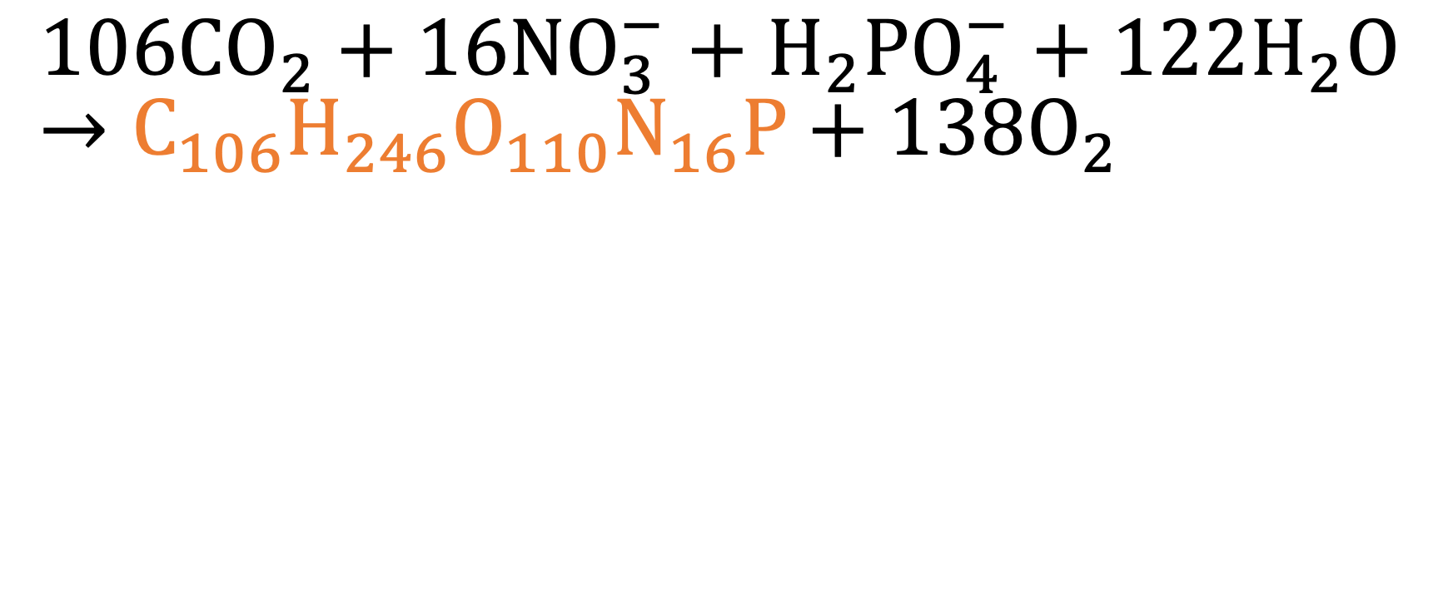
When things grow, they take nutrients with them
$$106CO_{2}+16NO_{3}^{−}+H_{2}PO_{4}^{−}+122H_{2}O→C_{106}H_{246}O_{110}N_{16}P+138O_{2}$$

Slide 21
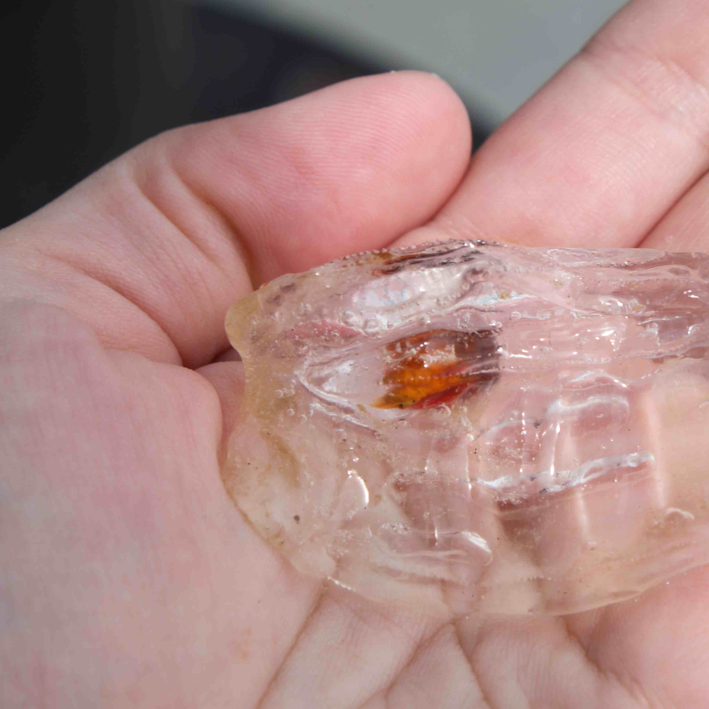
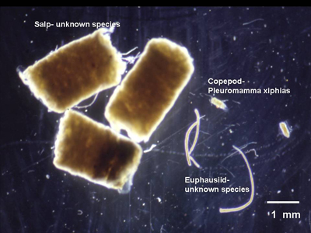
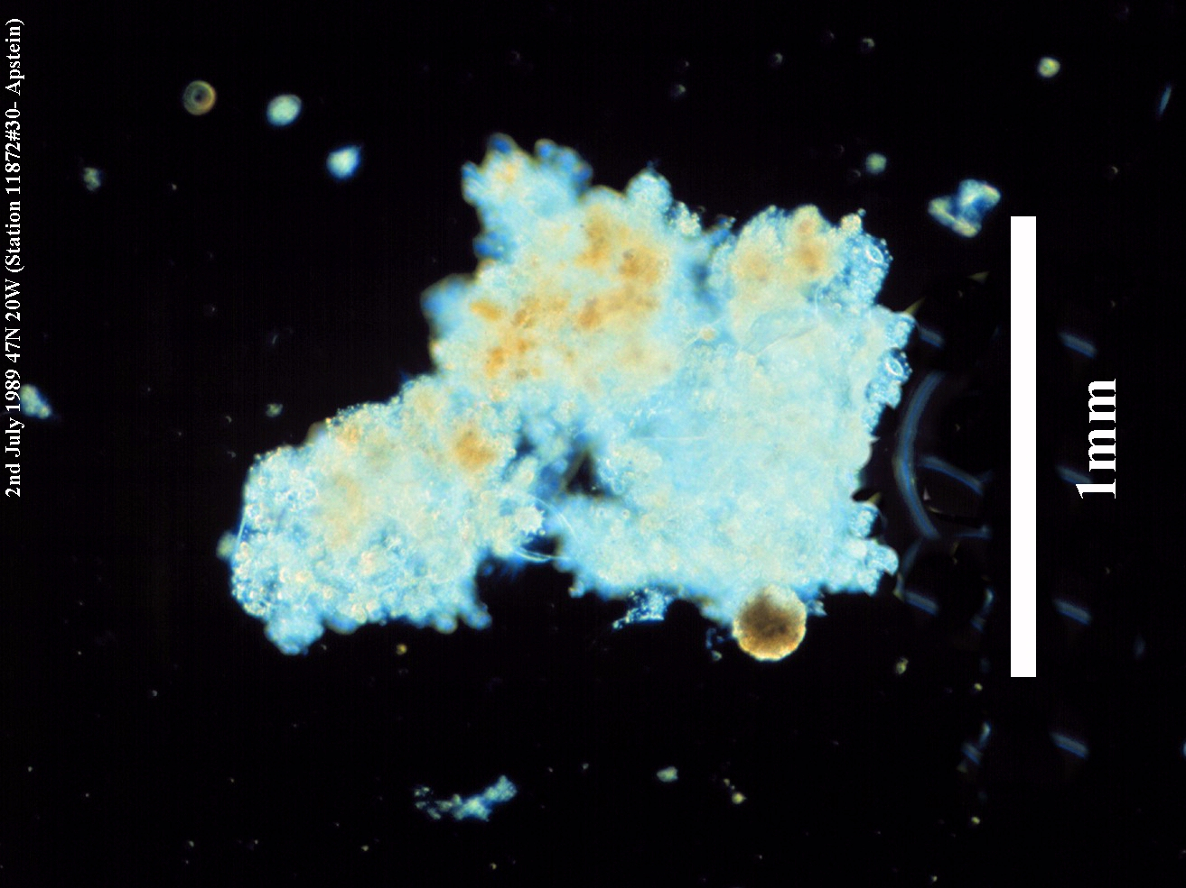

When particles sink, they export (and potentially bury) these nutrients
Salp – L. Koren
Marine Snow – Richard Lampitt
Zooplankton Fecal Pellets – Debbie Steinberg

Slide 22
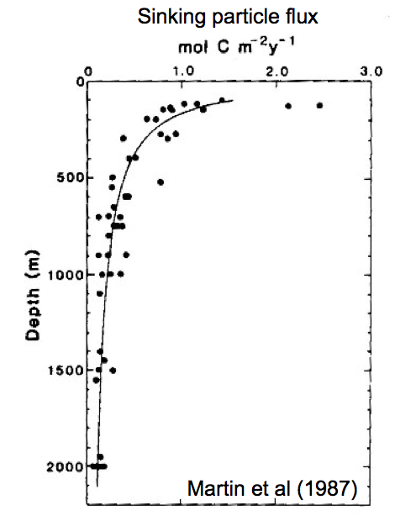
The sinking of ocean particles determines deep ocean activity
10-30% of NPP from euphotic zone sinks
Less than 1% of particles that sink actually reach bottom
Mostly, nutrients are remineralized as organisms consume and use them

Slide 23
And that’s not even half the story!
Wikimedia Commons

Slide 24
And that’s not even half the story!
Instead of cycling, biomass gets shunted straight back to the dissolved and particulate pools.
This makes it available to microbes, and reduces export in the short term.
(30-100% is eaten by grazers)
10-50% (!!!) of daily production is “consumed” by viruses!
Wikimedia Commons

Slide 25
The biological pump is relevant to global biogeochemical cycles
Falkowski et al. 2007

Slide 26
How can we contextualize phytoplankton sizes and functions?

Slide 27
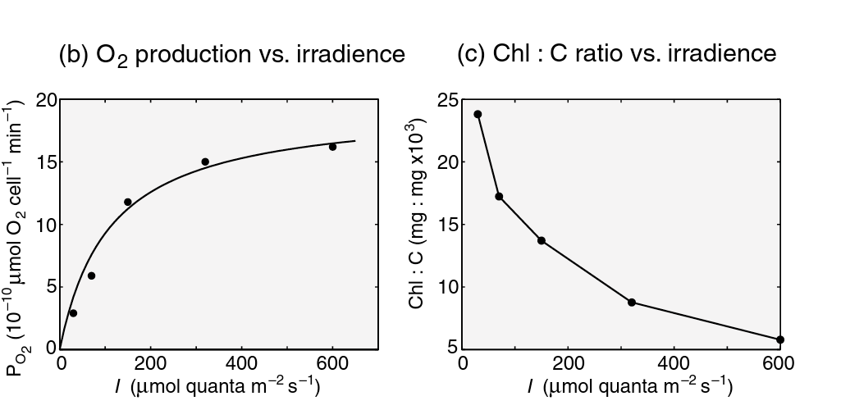
Photosynthesis (and chlorophyll) saturates at high irradiance levels

Slide 28
The mind-boggling scales of (marine) phytoplankton

Slide 29
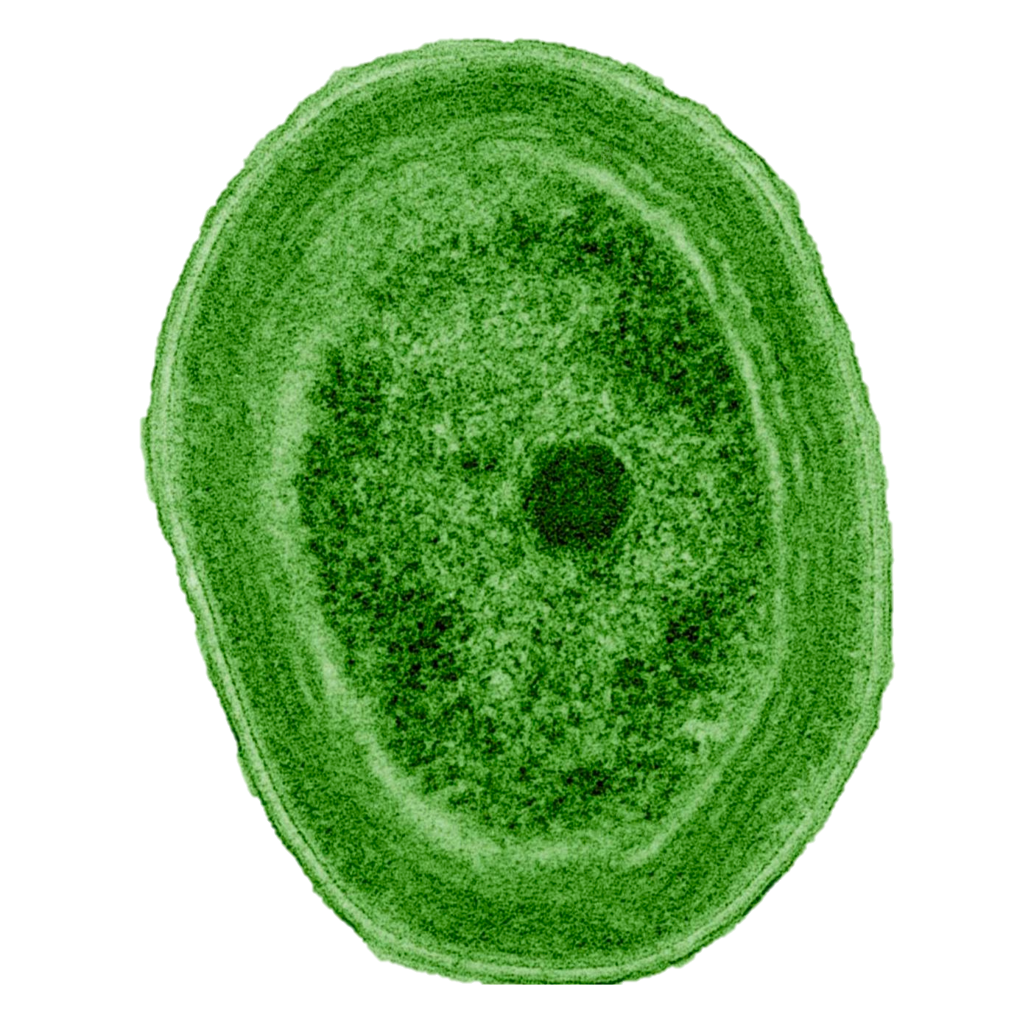
The mind-boggling scales of (marine) phytoplankton
Prochlorococcus
0.7 microns
(20 inches)

Slide 30
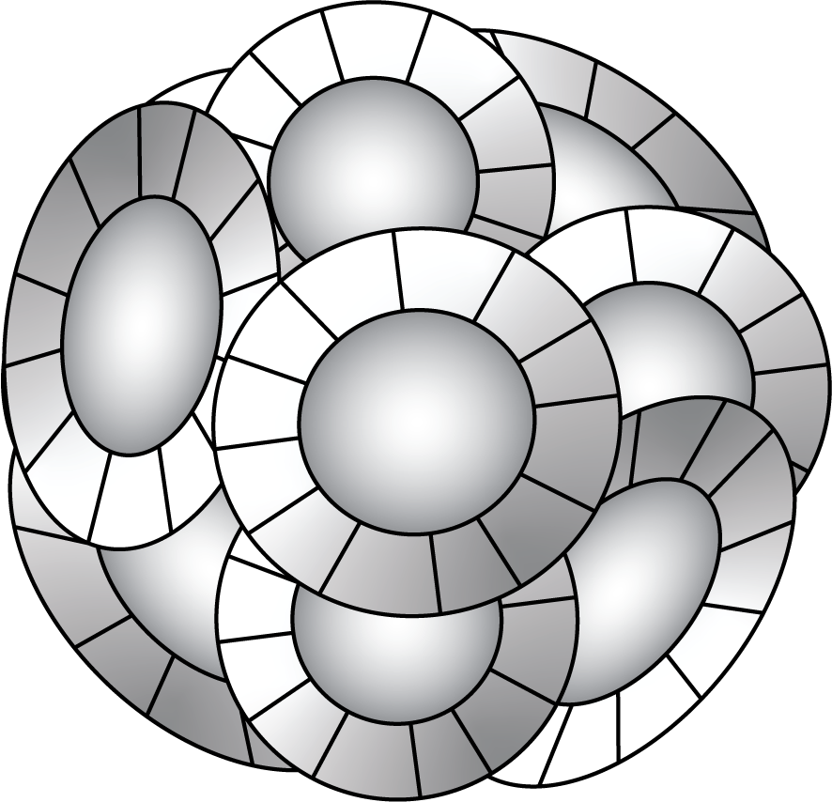
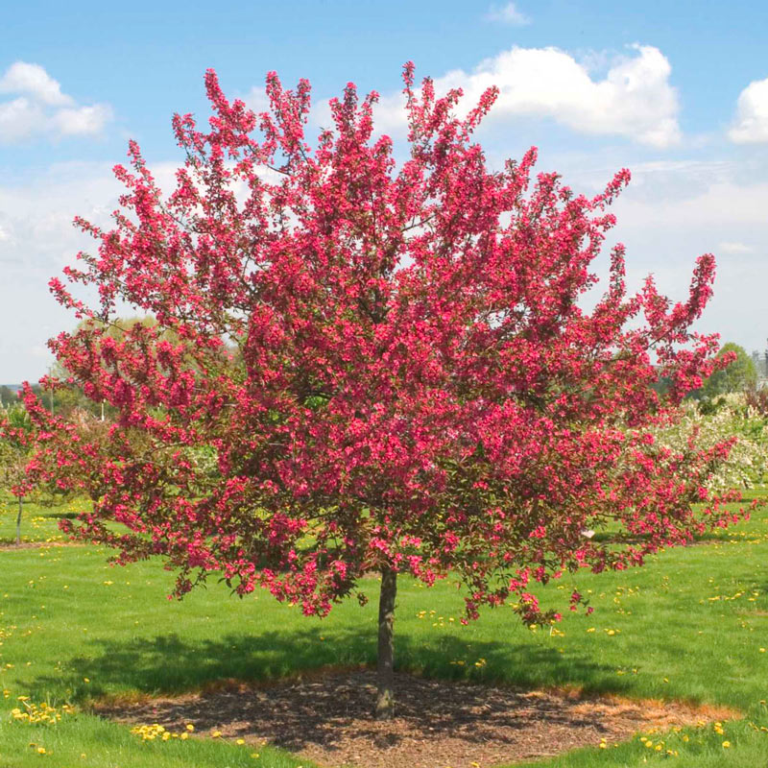
The mind-boggling scales of (marine) phytoplankton
5-20 microns
(10x bigger than 0.5)
Prochlorococcus
Emiliania huxleyi
0.7 microns
(20 inches)

Slide 31
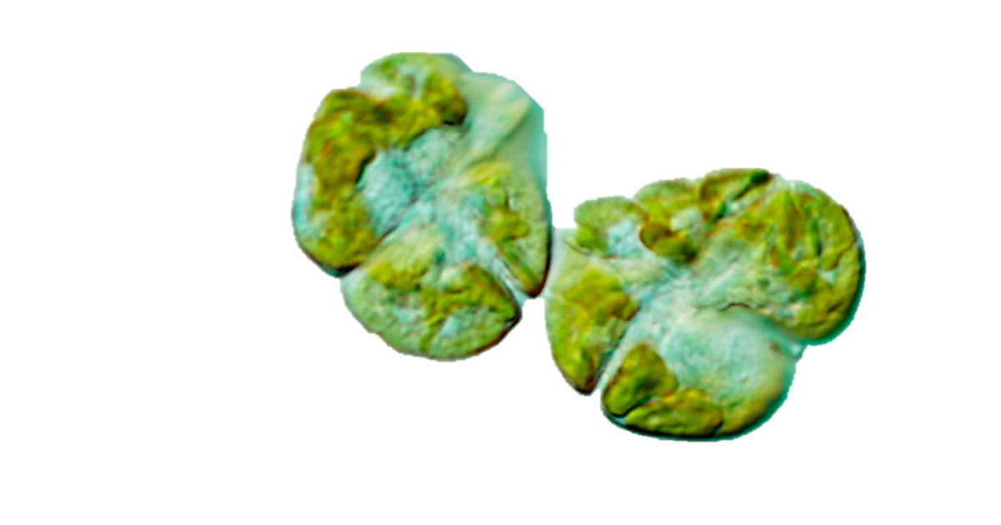
The mind-boggling scales of (marine) phytoplankton
Karenia brevis
Prochlorococcus
Emiliania huxleyi
5-20 microns
(10x bigger than 0.5)
0.7 microns
(20 inches)
Ha’Penny Bridge
Dublin, Ireland
(135 feet)

Slide 32
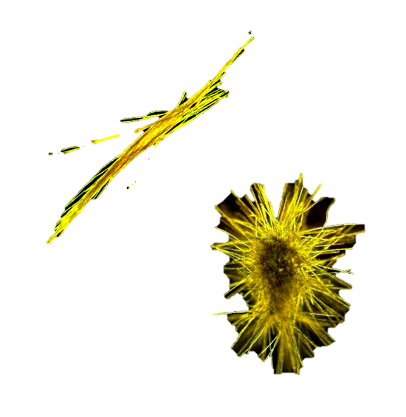
The mind-boggling scales of (marine) phytoplankton
Mauna Loa
Hawaii
30,000 feet
Trichodesmium
Prochlorococcus
Emiliania huxleyi
5-20 microns
(10x bigger than 0.5)
Karenia brevis
0.7 microns
(20 inches)
Ha’Penny Bridge
Dublin, Ireland
(135 feet)

Slide 33
Major functional classes of phytoplankton
Calcifiers
Nitrogen fixers
Silicifiers
DMS producers

Slide 34
Other ecologically-relevant microbes (not for today)
Traditional denitrifying + nitrifying bacteria + archaea
Anammox-involved bacteria + archaea
Also in hydrothermal vents – whole other topic!!

Slide 35
Coccolithophores

Slide 36
Calcification: an enigmatic process
Calcifiers are abundant, and the calcification process is complex with respect to global CO₂

Slide 37
Calcification: an enigmatic process
No one quite knows how calcifiers afford the energetic costs of calcification

Slide 38
Calcification can result in large-scale calcite formations after blooms + deposits

Slide 39
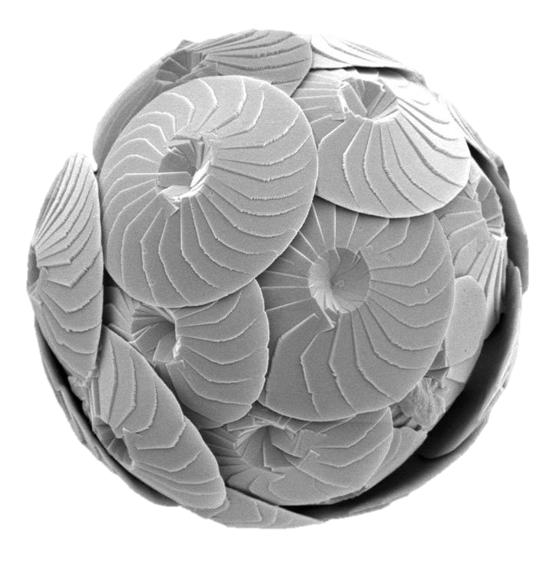
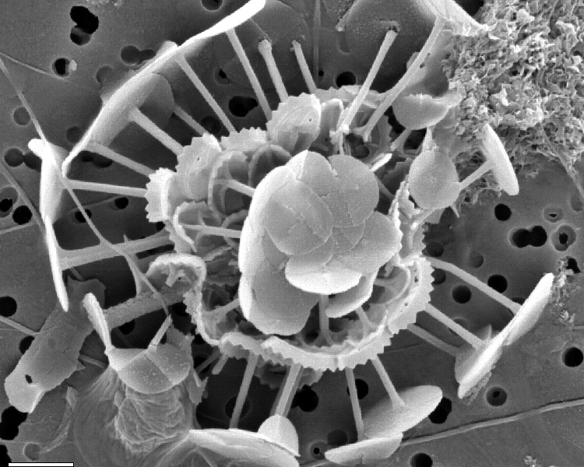
Some example calcifiers
Emiliania huxleyi
Haptophyte
Associated with EhV, large viruses that collapse blooms
Coccolithophore poster child
Calcidiscus leptoporus
Papposphaera lepida

Slide 40
DMS production in Emiliania huxleyi
Curson et al. 2018

Slide 41
Dinoflagellates

Slide 42
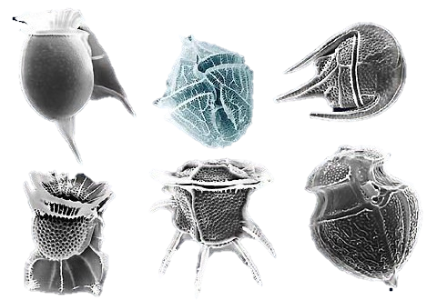
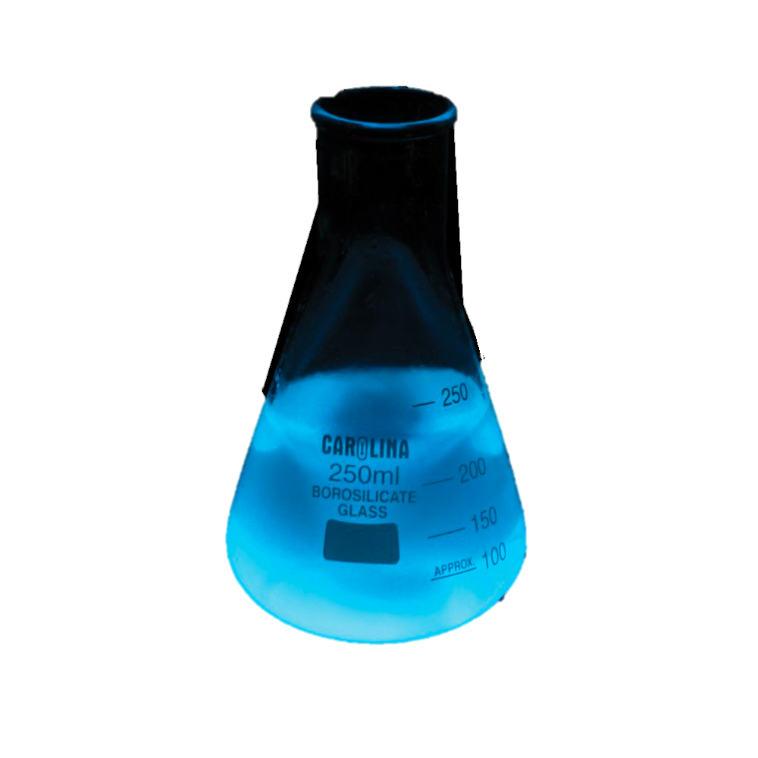
Toxic bloom-formers
This is one of the most diverse groups of phytoplankton around
Includes red tide species Karenia brevis
Also responsible for a lot of surface bioluminescence

Slide 43
Dinoflagellates have complex evolutionary histories
Many phytoplankton gained photosynthetic ability through acquiring plastids
This involves an endosymbiotic event, in which a photosynthetic bacterium is engulfed and eventually it becomes an organelle rather than a separate organism
In dinoflagellates this has happened multiple times independently

Slide 44
Kleptoplasty – piecewise motion towards photosynthetic ability

Slide 45
Diatoms
Silica + high-nutrient conditions

Slide 46
Diatoms thrive early in the season, when nutrients are high and there might be a lot of mixing
Diatoms have hard silica (SiO2) “frustules” that make them resistant to the damage that can be caused by turbulent waters
They are good at exploiting high nutrient conditions
Because they are bulky, they don’t have the best surface area: volume ratios for uptake, but they can take advantage of stocking up on nutrients when they are abundant

Slide 47
Diatoms can potentially manipulate their position in the water column
They can move about by controlling how quickly they sink
Being bulky, they would ordinarily sink quickly, but they may be able to ballast to keep themselves afloat
Bulky glass shells may protect them from predators

Slide 48
The end of diatoms’ life
As diatoms die, they sink and form diatomaceous earth material
Chalky + lightweight
Actually used to manufacture explosives
You may have seen the material in the garden center for pest control when planting

Slide 49
Ciliates

Slide 50
Ciliates are important heterotrophic protists
Chow down on biomass of bacteria and smaller eukaryotic phytoplankton
Form a key link in the microbial loop
Also kleptoplastidic

Slide 51
Oligotrichs

Slide 52
Choreotrichs (including tintinnids)
Lorica are the shells
So, they’re preserved like diatoms + coccolithophores
Generally considered zooplankton/heterotrophs

Slide 53
Mixotrophy
Constitutive: their own permanent plastids
Non-constitutive: steal plastids from consuming others

Slide 54
Mixotrophy
Constitutive: their own permanent plastids
Non-constitutive: steal plastids from consuming others
Heterotrophy
Phototrophy

Slide 55
Mixotrophy
Constitutive: their own permanent plastids
Non-constitutive: steal plastids from consuming others
Heterotrophy
Phototrophy
Their consumption of other organisms doesn’t cut it!

Slide 56
Mixotrophy
Constitutive: their own permanent plastids
Non-constitutive: steal plastids from consuming others
Heterotrophy
Phototrophy
They have all the machinery to provide for themselves, but they’re engaging in mixotrophy on the side!

Slide 57
Margalef’s Mandala

Slide 58
Redfield Ratio
C
P
N
1
16
106

